Slide 2
2023 NT ACE Conference Audit Poster Style Guide
The rules
Please submit your audit poster using the template we’ve made available for you to download as a .ppt or .pptx file.
Video clips may be used. They should be embedded (not linked) and set to play automatically and loop continuously.
Animations (text builds etc.) can also be used. We advise using them sparingly. They will need to be set to transition at timed intervals.
Sound is not supported. No audio.
Presenters must declare on their poster whether or not they have a conflict of interest, i.e. personal, professional or business affiliation relevant to the presentation. Sources of funding, equipment or other support must be given.
You should not feel constrained by the design guidelines that appear on the following slides. Our hints and tips are just that, and ultimately it’s up to you.

Slide 3
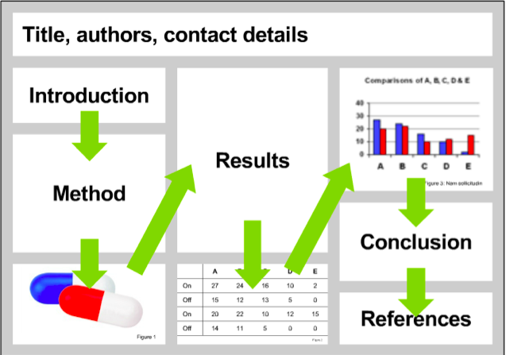
2023 NT ACE Conference Audit Poster Style Guide
Start by designing your layout
Anyone viewing your poster should be able to easily understand the sequence of information.

Slide 4
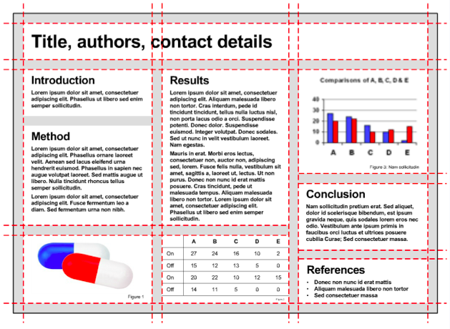
2023 NT ACE Conference Audit Poster Style Guide
Layout design
The example here shows an effective layout because it has been organised into a grid.
To enable gridlines navigate to the View tab in the ribbon, then tick the Guides box.

Slide 5
Example poster with video
Introduction
Method
At vero eos et accusamus et iusto odio dignissimos ducimus qui blanditiis praesentium voluptatum deleniti atque corrupti quos dolores et quas molestias excepturi sint occaecati cupiditate non provident, similique sunt in culpa qui officia deserunt mollitia animi, id est laborum et dolorum fuga. Et harum quidem rerum facilis est et expedita distinctio. Nam libero tempore, cum soluta nobis est eligendi optio cumque
At vero eos et accusamus accusamus et iusto odio et iusto odio dignissimos ducimus qui blanditiis praesentium voluptatum deleniti atque corrupti quos dolores et quas molestias excepturi sint occaecati cupiditate non provident, similique sunt in culpa qui officia deserunt mollitia animi, id est laborum et dolorum fuga.
At vero eos et accusamus et iusto odio dignissimos ducimus qui blanditiis praesentium voluptatum deleniti atque corrupti quos dolores et quas molestias excepturi sint occaecati cupiditate non provident, similique sunt in culpa qui officia deserunt mollitia animi, id est laborum et dolorum fuga. Et harum quidem rerum facilis est et expedita distinctio. Nam libero tempore, cum soluta nobis est eligendi optio cumque nihil impedit quo minus id quod maxime placeat facere possimus, omnis voluptas assumenda est, omnis dolor repellendus. Temporibus autem quibusdam et aut officiis
At vero eos et accusamus et iusto odio dignissimos ducimus qui blanditiis praesentium voluptatum deleniti atque corrupti quos dolores et quas molestias excepturi
At vero eos et accusamus et iusto odio dignissimos ducimus qui blanditiis praesentium voluptatum deleniti atque corrupti quos dolores et quas molestias excepturi
Conclusion
Results
At vero eos et accusamus et iusto odio dignissimos ducimus qui blanditiis praesentium voluptatum deleniti atque corrupti quos dolores et quas molestias
At vero eos et accusamus et iusto odio dignissimos ducimus qui blanditiis praesentium voluptatum deleniti atque corrupti quos dolores et quas molestias excepturi sint occaecati cupiditate non provident, similique sunt in culpa qui officia deserunt mollitia animi, id est laborum et dolorum fuga. Et harum quidem rerum facilis est et
References
At vero eos et accusamus et iusto odio dignissimos

Slide 6
Audit poster title, author/s
Here’s a blank template to get you started

