Slide 1

ANZCA guided
discussion package
Gender Equity Sub-committee

Slide 2

Acknowledgement of Country
Wominjeka - come into your purpose
Artwork by Bitja Dixon
Represents our role in the healing journey for patients

Slide 3
Karakia (Māori prayer/incantation)
E te hui Whāia te mātauranga kia mārama Kia whai take ngā mahi katoa Tū maia, tū kaha Aroha atu, aroha mai Tātou i a tātou katoa Kaitito (Author): Huirangi Waikerepuru | For this gathering Seek knowledge for understanding Have purpose in all that you do Stand tall, be strong Let us show respect For each other

Slide 4
Invest in women: Enhance progress
This presentation is intended to facilitate discussion within groups of anaesthetists and specialist pain medicine physicians – we strongly encourage you to be open to discussion around the topics.
Five themes are presented using four slides (~10 mins per topic)
  Information from current literature.
  Questions to discuss.
  Where to get more information.
The ANZCA website has a gender equity LibGuide that collates many of the resources referenced.

Slide 5
Gender equity is a global health and economic crisis
Not a numbers problem
An influence problem
Slide recreated with permission from Dr Kara Allen

Slide 6
Based on current trends, how long will it take to achieve gender equity globally?
According to the World Economic Forum
132 years
2020: 100 years
Changes due to Covid-19
(Metrics: Economic Participation and Opportunity, Educational Attainment,
Health and Survival, and Political Empowerment)
Slide recreated with permission from Dr Kara Allen

Slide 7
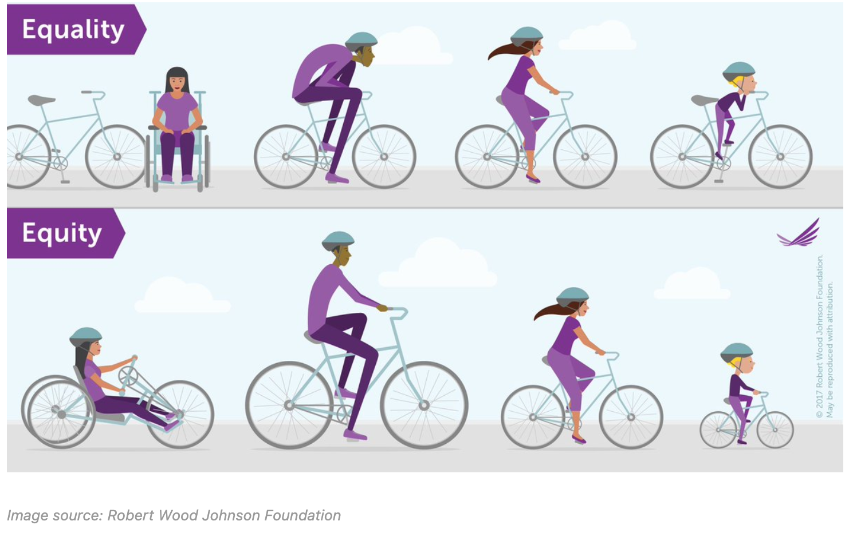
Discussion
What does gender equity look like?
What are some barriers to gender equity?
Does anyone have personal stories they would like to share?

Slide 8

THEME 1
Mentoring

Slide 9
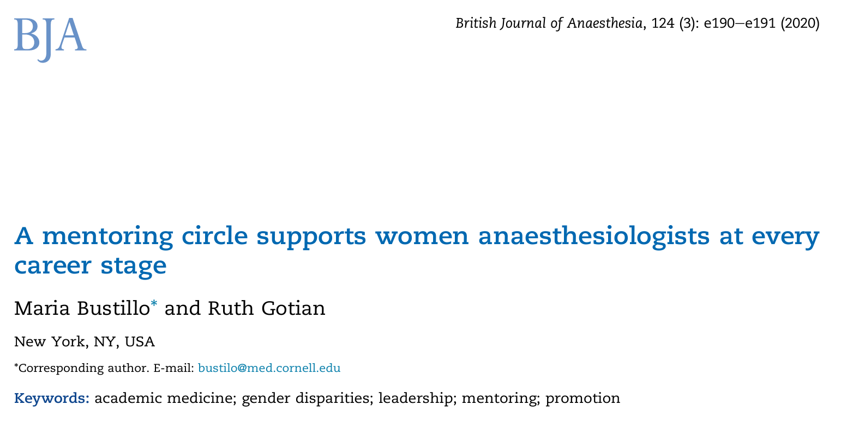
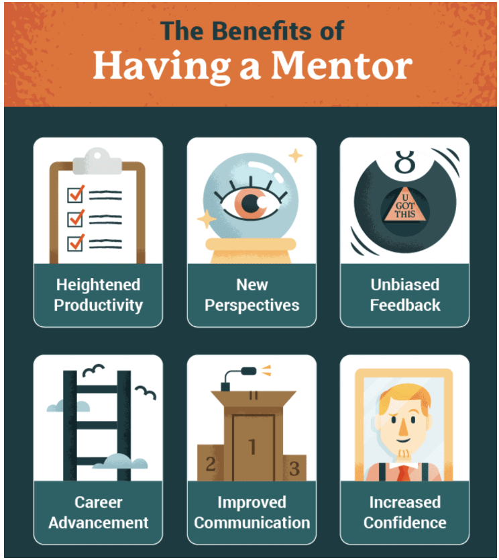
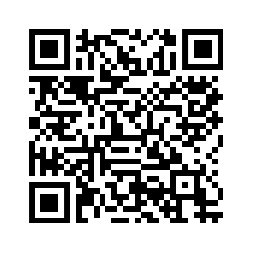
https://www.letseatgrandma.com/blog/benefits-of-having-a-professional-mentor/

Slide 10
Mentoring
Do you have a mentoring program?
Is there a difference between mentoring and sponsorship?
Can anyone share a mentoring story from their career?

Slide 11
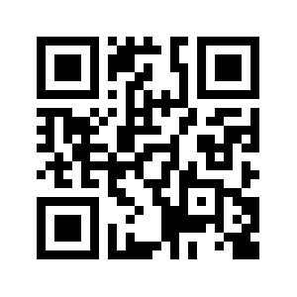
Women’s Empowerment and Leadership Initiative
Currently enrolling both mentors (of any gender or specialty) and mentees (female or non-dominant gender).
Scan QR code
https://ausnzweli.org

Slide 12
THEME 2
Gender pay gap

Slide 13
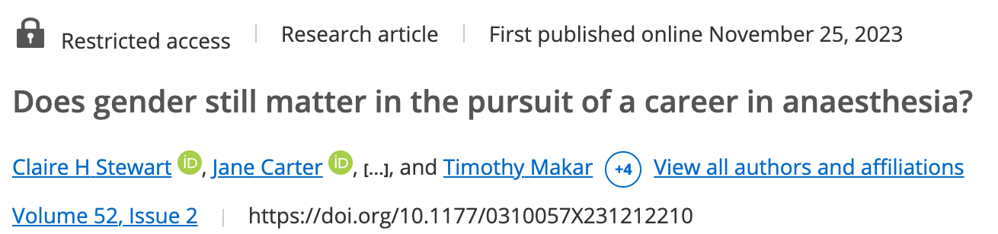
Taking into account public work percentage
and hours worked there was still a
$65k gender salary difference
(95%CI of $30k - $95k).
Age or years since FANZCA did not affect this value.
Within the limitations of converting an ordinal outcome to a continuous outcome a multivariable linear regression model (residuals ok, some heteroskedacity).

Slide 14

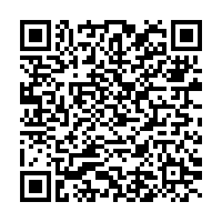
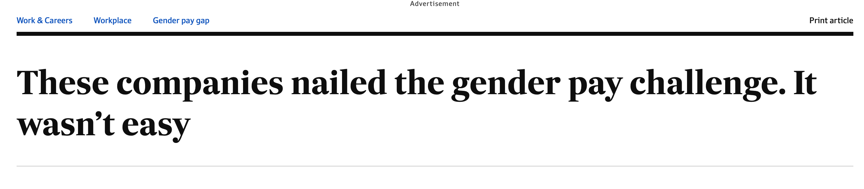
Pay gap
Is there a gender pay gap in your department?
Do anaesthetists of all genders partake in paid parental leave and caregiving responsibilities?
Notes:
https://www.afr.com/work-and-careers/workplace/these-companies-nailed-the-gender-pay-challenge-it-wasn-t-easy-20240223-p5f7ch

Slide 15
ANZCA has published their college employee metrics regarding the pay gap.
Workplace Gender Equality Agency
Now publishes all data for gender pay gap in companies > 100 employees.
ANZCA continues to work on projects around paid parental leave and less than fulltime work, which we hope will contribute to reducing the gender pay gap.

Slide 16
THEME 3
Leadership

Slide 17
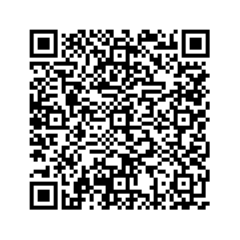

Slide 18
Leadership
What is the gender breakdown for leadership in your department?
How are leadership roles selected?
Are those in less than fulltime roles recognised for opportunities?

Slide 19
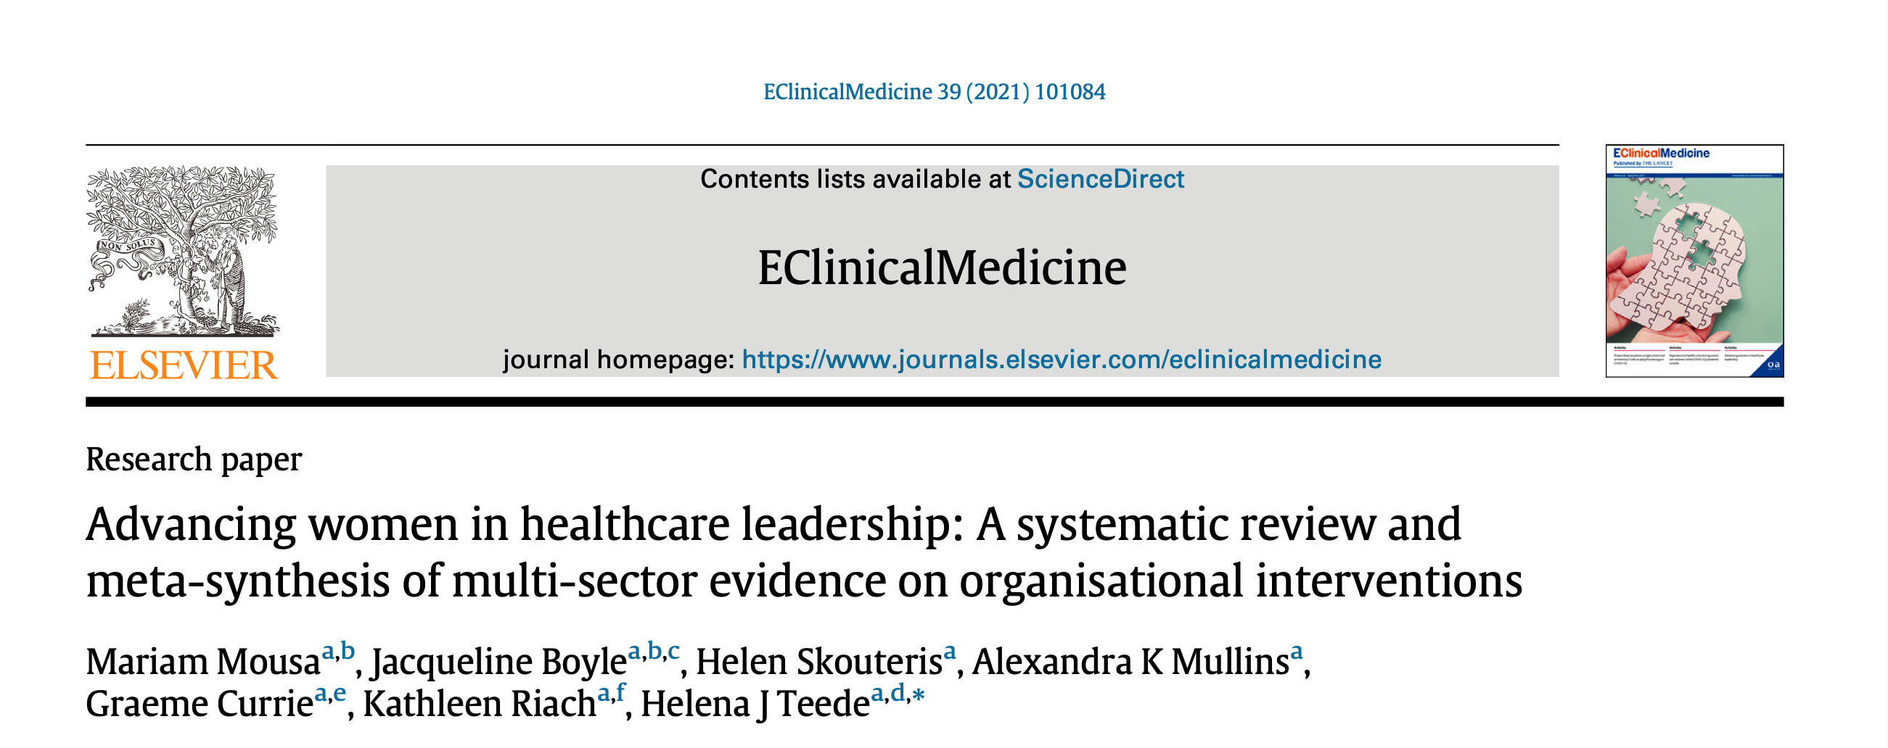
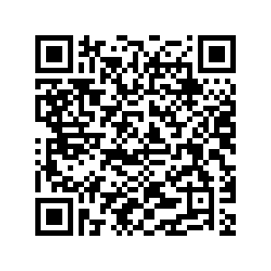
Organisational processes
Awareness and empowerment
Mentoring and networking
Retention, promotion and evaluation
Leader training and empowerment
Slide recreated with permission from Dr Kara Allen

Slide 20
ANZCA’s Gender Equity Sub-committee is launching a
“Survey toolkit”
at the 2024 ASM in Brisbane
that will help departments measure
their gender metrics.

Slide 21
THEME 4
Intersectionality

Slide 22
During my anaesthesia career I have experienced discrimination due to my | OR for females vs males (95% CI) | p | Demographics
Gender | 10.07 (6.71 – 15.11) | <0.001 | 157 male, 285 female, 442 total
Ethnicity | 1.67 (1.17 – 2.40) | 0.005 | 154 male, 261 female, 415 total
Relationship Status* | 6.41 (2.86 – 14.37) | <0.001 | 154 male, 278 female, 432 total
Age | 2.43 (1.69 – 3.50) | <0.001 | 157 male, 281 female, 438 total
Sexual Orientation | 1.56 (1.05 – 2.34) | 0.03 | 128 male, 229 female, 357 total
Religion* | 0.42 (0.17 – 1.08) | 0.071 | 132 male, 217 female, 349 total
*Logistic regression where agree and strongly agree is compared with others

Slide 23
Intersectionality
Do you recognise the various minority groups members of your department identify with?
  Gender, pronouns, LGBTQIA+, First Nations, religion, language spoken at home.
Are you flexible in allowing people to express their cultural practices?

Slide 24
ANZCA has a recorded webinar about why “Pronouns matter” online.
ANZCA accepts the ACON training modules for CPD points.

Slide 25
THEME 5
Unconscious bias

Slide 26
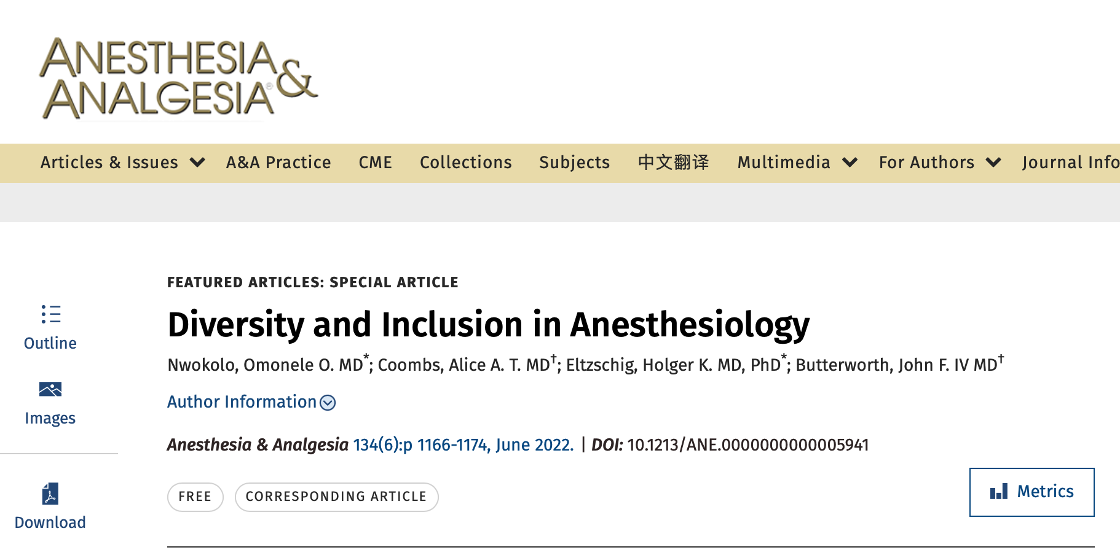
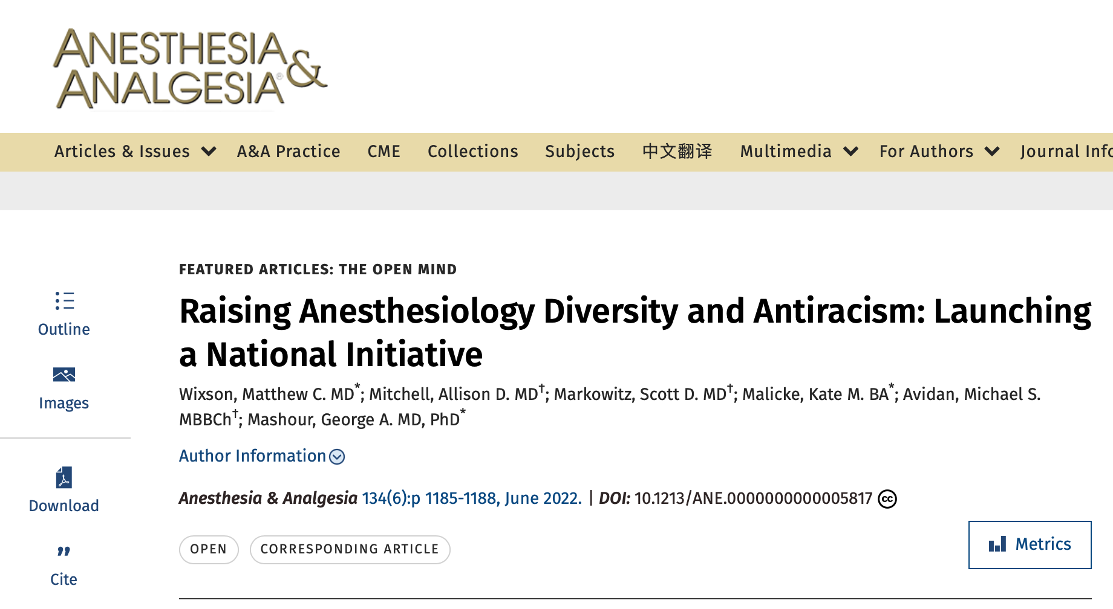
Strategies for Diversity and Inclusion
Outreach
Buy In
Mentorship
Fair Culture
Targeted Recruiting
Diversity Leadership
Diversity Training
Education
Slide recreated with permission from Dr Kara Allen

Slide 27
Selection criteria when hiring
How are selection committees chosen in your department?
Do you encourage (or mandate) unconscious bias testing of your selection panel members?
Do you ensure that a balanced perspective for “merit” is represented in selection questions?

Slide 28
ANZCA has an “Unconscious bias toolkit”
We recommend all members of a selection panel have completed unconscious bias testing, and that these biases are declared when the panel is created.

Slide 29

Thankyou for participating

Slide 30
Upcoming events
“Menopause matters” webinar Thursday 21 March 6-7pm
Gender Equity Subcommittee at the ASM
  Concurrent session on Sat 4 May from 1.30-5pm.
  Come, meet the team and engage with our projects.
“Women in STEMM” breakfast at ASM Monday 6 May at 7.15 am
  Allies of all genders welcome!
WELI recruitment for mentoring at ASM Monday 6 May 1.30-3pm
Please contact ge@anzca.edu.au to get involved.

